Slide 1
Talk for the Berkeley Language Center, 5 Feb 10 Communicating Grammatically: Evaluating a Learner Strategies Website for Spanish Grammar
Andrew D. Cohen adcohen@umn.edu
with
Angela Pinilla-Herrera pinil001@umn.edu,
Jonathan Thompson thom2532@umn.edu,
& Lance Witzig witz0043@umn.edu

Slide 2
Spanish Grammar Strategies Website – The Rationale
While attention is focused on the teaching of grammar, not very much attention is paid to how learners are to go about learning and performing it.
Grammar forms are not just magically acquired.
Learners encounter grammar forms that are problematic, regardless of how well they are presented in textbooks or in class.
“At heart, learning depends on the
student“ (Oxford & Lee, 2007).
[Oxford, R. L. & Lee, K. R. (2007). L2 grammar strategies: The second Cinderella and beyond. In A. D. Cohen & E. Macaro (Eds.), Language learner strategies: 30 years of research and practice (pp. 117-139). Oxford: Oxford University Press.]

Slide 3
Main Objective
This website is dedicated to the pursuit of ways to enhance learners’ control of Spanish grammar.
How?
By providing examples of strategies that learners of Spanish have used successfully in their efforts to deal with problematic grammar.
Grammar strategies are deliberate thoughts and actions that learners consciously employ in order to have better control of grammar structures.

Slide 4
Where did we find these grammar strategies?
From learners themselves: The website features strategies deployed successfully by learners, including strategies from nonnative teachers of Spanish – who must learn and perform Spanish grammar if they are going to teach it to others.
So, rather than being a repository of Spanish grammar rules (which can be found elsewhere on the web), this website is intended to offer a representative set of strategies for dealing with problematic grammar – offered by numerous learners who have “been there and done that” successfully. (We’ve checked to make sure that they do have control over the forms that they’ve shared their strategies for.)

Slide 5
Gathering the Strategies & Planning the Website
August of 2007 – initial effort involving the design of online surveys (5 versions for learners [N=111] and 2 for instructors [N=24]) as to what they considered to be problematic grammar forms in Spanish.
Subsequently, 28 students and 8 NNS teachers interviewed with videotaping, use of a Cyberpad and class notes.
45 hours of taping produced 66 usable video-clips.
Videotaping digitized.
Project advisor, Rebecca Oxford.

Slide 6
Organization of the Website - http://www.carla.umn.edu/strategies/sp_grammar
Introduction
Reasons for using strategies to learn and perform Spanish grammar
Definition and example of a grammar strategy
Questions to promote self-awareness of current language strategy use
Purpose of the website
Factors that influence the choice and effectiveness of grammar strategies
Learning Style Survey
Rationale for using particular strategies
Glossary

Slide 7
Organization of the Website
How can I use this website?
“I’m looking for a strategy that someone has used successfully to learn a specific grammar form.”
“I’m looking for strategies that match my learning style and that can apply to various grammar forms.”

Slide 8
“I’m looking for a strategy that someone has used successfully to learn a specific grammar form.”
Tenses
Preterite
Imperfect
Preterite vs. imperfect
Moods
Subjunctive
Imperfect subjunctive
Conditional
Conditional perfect and pluperfect subjunctive
Commands
Pronouns
Simultaneous use of direct and indirect object pronouns
Reflexive pronouns in present perfect constructions
Direct and indirect object pronouns in affirmative and negative tú commands
Relative pronouns

Slide 9
“I’m looking for a strategy that someone has used successfully to learn a specific grammar form.”
Ser vs. Estar
Por vs. para
Negative words
Superlatives
Hacer and desde in time expressions
Other
Lo + adjectives
Gender and number agreement
Gender of nouns
Demonstrative adjectives

Slide 10
“I’m looking for strategies that match my learning style and that can apply to various grammar forms.”
Auditory
Rhymes
Songs and chants
Talking to native speakers
Visual
Color coding
Decision maps
Drawings / mental images
Note cards
Playing with verbs
Quasi-math formulas
Quick grammar references
Kinesthetic
Physical behaviors
Writing it over
Memory aids
Acronyms
Initials as a vehicle for mnemonics
Phrases as memory aids
Phrases as vehicles for syntax

Slide 11
Cognitive
English sentences with Spanish syntax
English sentences with Spanish words inserted
Focusing on meaning
Learning materials as a chunk
Learning grammar by explaining it to others
Using archetypal sentences
Using L1 to keep forms and functions straight
Context-based
Making associations
Observing use of the form in context
Other
Avoiding avoidance
Combining perceptual modes

Slide 12
Examples from the Website
I need a strategy
for a particular grammar form.

Slide 13
Ser and estar (Main page)
As a learner and user of Spanish, you need to deal with two main verbs used to express the English verb 'to be‘ – ser and estar. As you have probably discovered, deciding whether to use one form or the other can be a challenge.
The following strategies have proven useful for many beginning learners.
When to use ser and estar
Acronyms for the basic differences
Observing contextual use
When to use ser
Association by the first sound of the word
When to use estar
A rhyme
A phrase with an acronym in it

Slide 14
A phrase with an acronym in it
Ser and estar (strategy)
A nonnative teacher uses "CLING to a star/estar" to help her students remember that estar is necessary when talking about:
Temporary conditions
Lola está embarazada y su esposo está asustado.
Location
La sección de maternidad está en el segundo piso del hospital.
-ing forms in English
El bebé está llorando.
Notes:
A teacher uses "CLING to a star/estar" to help her students remember that estar is necessary when talking about:
Temporary conditions
Example: Lola está embarazada y su esposo está asustado. 'Lola is pregnant and her husband is scared.' (Lola's pregnancy is temporary since it lasts only 9 months. It is expected that her husband will stop being scared after a while.)
Location
Example: La sección de maternidad está en el segundo piso del hospital. 'The maternity unit is on the second floor of the hospital.' (To reveal the location of the maternity unit, estar is required.)
-ing forms in English
Example: El bebé está llorando. 'The baby is crying.' (To express ongoing -ing actions in English the auxiliary verb estar is always required in Spanish.)

Slide 15
I want strategies that fit my learning style preferences.

Slide 16
Songs and chants (Main page)
Auditory
Verb endings and especially irregular forms can be challenging. Because they are not easily learned with simple rules, you have to figure out ways to memorize them. One way is through songs or chants.
A song (Irregular preterite forms)
A song (Irregular tú commands)
A song (Negative tú commands)
A chant (Present tense forms)
A chant (Preterite endings)
A chant (Irregular tú commands)
A chant (Irregular subjunctive forms)

Slide 17
A song (Irregular tú commands)
A students, Sam, explains how singing the irregular tú commands to the tune of “Row, row, row your boat” helps her remember the irregular forms. Notice that she uses repetition in her song to help her remember the forms.

Slide 18
The Nature of the Website
72 strategies found to be effective.
Strategizing about the learning and use of Spanish grammar.
Not a Spanish grammar website.
Wide variety of strategies -- related to perceptual styles, cognitive strategies, memory strategies, and other strategies with defy classification.
Rules of grammar or rules of thumb (Negueruela & Lantolf, 2006).

Slide 19
Research Project
Purpose: To evaluate the effectiveness of the website
UROP grant awarded to undergraduates Jonah Thompson and Lance Witzig in the Spring of 2007.
Grant provided funds to offer participants gift certificates at the University bookstore.
Unique niche for this study: researching strategies at a high level of specificity – unlike in other studies where a strategy is much less fine-tuned – e.g., “I use a dictionary.”

Slide 20
Research Questions
1. To what extent do learners perceive the strategies that they select are helpful in improving their Spanish?
2. What are the learners’ reasons for choosing the strategies that they chose?
3. How are specific strategies received by learners?
4. What are the learners’ overall impressions of the website?

Slide 21
Research Design
Sample
Recruitment of participants: February 2009
15 students volunteered
5 Spanish majors, 9 Spanish minors, 1 neither
11 females, 4 males
Majority of students with intermediate mid proficiency – recruited mainly from 5th-semester Spanish
Two 4th-semester students
One student preparing his final seminar project for the Spanish major.

Slide 22
Treatment
Orientation to website – February, 2009
How to use the website
Introduction to Strategy Tracking Form
Participants were asked to fill in the tracking form only about the strategies they thought might be helpful to them.
Participants had free rein of the Spanish Grammar Strategies Website

Slide 23
Instrumentation
Orientation to website and its rationale, purpose of research, Strategy Tracking Form
First Interview
Collecting data on subjects’ experiences with the strategies
Collecting demographics on participants – classes, major/minor, Spanish proficiency
Reasons for studying Spanish, attitudes re grammar, learning style preferences
Second Interview
Update on previously reported strategies and report on new ones

Slide 24
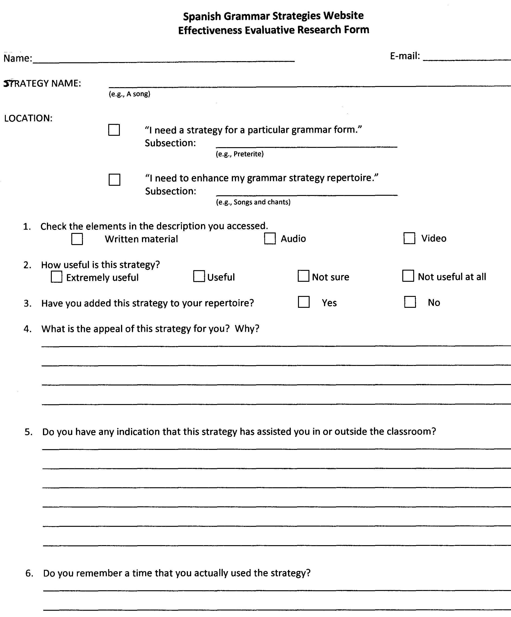

Slide 25
Data Collection Procedures
From 6 to 8 weeks, between orientation (February, 2009) and interviews
Going over Strategy Tracking Forms – Students reported on at least 4 strategies
Interviews 20-25 minutes on the average
Witzig audio-taped most interviews, Thompson took notes on student responses

Slide 26
Procedures for Data Analysis
A three-point scale was used for rating the reported helpfulness in learning Spanish grammar that a given strategy provided: “helpful,” “not helpful,” and “unclear” (in cases where still no empirical evidence regarding the helpfulness of a strategy).
Looked for student language positively describing the utility of the strategy for them, as well as evidence that they had actually used the strategy in order to determine whether the given strategy improved the subjects’ Spanish ability – e.g., Elise: “The rhyme completely cleared up any confusion I had been having…I use it all the time.”

Slide 27
1. To what extent did learners perceive the strategies that they had selected were helpful in improving their Spanish?
Results

Slide 28
Most of the strategies selected (77 out of 106 – 73%) were perceived by the learners to be helpful and to have improved their control over certain aspects of Spanish grammar (see Table 1).
While learners varied in their approach to and perception of different strategies, nonetheless all learners benefited from at least three strategies found on the website.

Slide 29
PERCEPTION REGARDING HELPFULNESS OF STRATEGIES | Strategy perceived as helpful | Strategy perceived as unhelpful | Unclear (i.e., no empirical evidence yet) | Total # of Strategies
Michiko | 9 | 0 | 0 | 9
Elise | 8 | 0 | 0 | 8
Molly | 8 | 1 | 1 | 10
Kallie | 7 | 0 | 0 | 7
Melanie | 6 | 0 | 0 | 6
Drew | 5 | 1 | 3 | 9
Mitch | 5 | 3 | 0 | 8
Erin | 5 | 4 | 0 | 9
Amber | 4 | 0 | 3 | 7
Layla | 4 | 1 | 0 | 5
Abby | 4 | 1 | 2 | 7
Daniel | 3 | 1 | 0 | 4
Anne | 3 | 2 | 0 | 5
Libby | 3 | 2 | 1 | 6
Vick | 3 | 2 | 1 | 6
TOTALS | 77 (73%) | 18 (17%) | 11 (10%) | 106 (100%)

Slide 30
Perceived Improvement
Classroom tasks: activities, tests, and writing assignments
Example:
Melanie mentioned that she used the PRINT vs. LITE acronym while writing drafts of her papers to help distinguish when to use ser or estar. She also noted using this last strategy on a test:
On our last Spanish exam we were working with ser vs. estar. It was on our study guide to go over the two in our book, but I found this strategy more helpful so I added it to my study guide instead and remembered PRINT and LITE on our test. I referred back to it during the test too and it helped me to correctly determine the situations where ser was needed, and the situations where estar was needed.

Slide 31
Ability and confidence: Using grammar forms that were at one time problematic or unclear
Example:
Abby noted that she consciously used a mnemonic device dealing with tu commands when she ordered food in Spanish.
Kallie explaining the usefulness of an acronym to help distinguish masculine and feminine nouns on a quiz:
It really helps to just remember a few irregular endings for masculine and feminine nouns. We were tested on the gender of some irregular nouns on our first quiz and remembering these endings really helped. I got 100%.
Students reported being generally more strategic in the overall learning process.

Slide 32
2. What were the learners’ reasons for choosing the strategies that they chose?

Slide 33
Strategy Selection
Explicitly encouraged to use the website just as they would if left to their own devices.
Found strong interest in seeking strategies for specific grammar forms, and particularly those which they struggled with or the forms that they were working on in class.
65 (61%) - strategies for specific grammar forms
41 (39%) - general strategies
Note: The distinction is a bit misleading since a fair portion of the strategies found through the general-strategy route nonetheless provided assistance with specific grammar forms.
Individual variation

Slide 34
Approach to Website
Individual variation in approaching the website
Melanie:
Initially spent 4-5 hours going through the majority of the strategies on the website and then focused only on those that really appealed to her.
Abby:
Visited the website fifteen minutes “here and there” looking for strategies that she needed for specific grammar forms, especially when writing papers.

Slide 35
Learning Styles Linked to Strategy Selection
Individual variation in how students used the website – some casually browsing the website for appealing strategies, others going directly to strategies needed for specific forms, still others spending considerable time looking through all the strategies in sequence to choose the strategies that piqued their interest.
Melanie: Visual learner for whom the first strategy was a decision map to distinguish between the preterite and the imperfect tense.
Molly: Visual learner who reported using a strategy to write all of the strategies that she found appealing on note cards.

Slide 36
Daniel: Went straight to strategies for specific forms and form use, particularly relating to the subjunctive mood.
Some students used their learning style preferences as a main factor in selecting strategies from the website.
[Note: At the time of the study, general strategies were not categorized by learning style preferences as they are now.]

Slide 37
3. How were specific strategies received by learners?
Positive Reception: 1. Auditory - rhyme – keeping the different demonstrative adjectives straight
Elise: This is a simple rhyme that has completely cleared up any confusion I had been having…When I am writing any of the demonstrative adjectives (este, esta, ese, esa…), I consciously think about this.
Erin: The rhyme was catchy. It was very brief and it was easy to remember demonstrative adjectives. This is one of the problems I encounter when I’m writing essays. I can’t determine when to use estos and esos or if estes even exists. It helps me with many of my writing assignments. Many words I use in my papers are estos, estas, esos, ese, etc. Now I can easily apply this fun, catchy line to help me (remember) when to use such words.

Slide 38
2. Por vs. para distinction - using English equivalents for por
Kallie: I used this strategy on my test last week for the por vs. para section. For each blank, I translated what the sentence was saying and chose the right word based on the equivalents I studied. I got my test back and got them all right!
Libby: It’s a very simple method for remembering the uses of por, and then inferring when to use para based on those conclusions… It’s a way to remember the distinction without memorizing extensive definitions for both por and para…I consciously remember the definitions when I am writing.

Slide 39
Vick: It was color-coded, which kind of made it more aesthetically pleasing. I think it was nice because it was short, and it had…equivalents like ‘by,’ ‘through,’ ‘in exchange for.’ This would have been super useful especially during the test…After seeing it and practicing with it a little bit you kind of start to get a feel: Instead of thinking of por as always ‘by,’ if you think of it as ‘through,’… or ‘in exchange for, ’ it makes more sense and it would probably help kids out a lot.
3. Tense/aspect – imperfect – acronym: DUWIT
Libby: …I’ve referred to the acronym to decide which tense to use. My % correct of fill-in-the-blank conjugation questions increased after using this strategy… My pre-test worksheet = 50% correct [before adding this strategy], my exam = 100% correct.

Slide 40
Mixed Reception: 1. Ser-estar distinction: an acronym – PRINT + LITE
Reported to be helpful –
Kathy: I definitely used this strategy when I was writing my mesa redonda [‘round table composition’], especially because I had to also decide between pretérito and imperfect, so it was nice to be more certain about which (ser or estar) to use and then figure out which tense.
Reported not to be helpful –
Mitch: I thought it could be useful, but realized that I have trouble remembering what the letters stand for… I’ll remember what the acronym is but not what each letter represents.

Slide 41
2. Auditory - memory aid - phrase (using Vin Diesel) to remember affirmative tú commands
Reported to be helpful –
Drew: It is an acronym that I can remember fairly easily… I have noticed that I am less hesitant when using the affirmative tú commands… The other day I was trying to tell one of the children in my class to “do it,” but I couldn’t think of the affirmative tú command for hacer, so I recalled the acronym and got haz.
Reported to be unhelpful –
Layla: I know there are a few irregular commands so I wanted to find a strategy for them all… What’s interesting is that I do remember this device; it sticks with me. I just choose not to use it. The way it sounds in my head does not at all relate to the irregulars: ven di sal haz ten ve pon sé…

Slide 42
4. What were the learners’
overall impressions of the website?

Slide 43
The majority of subjects seemed to find the website useful and planned to go on using it throughout their Spanish studies.
Others found it to be too simplistic and felt that it would be more appropriate for beginning learners, despite having gained more than two strategies that had high utility for them.
Some students felt that their experience in classroom Spanish had taken them beyond the level where they needed to work on grammar, making them unwilling to search for helpful material.

Slide 44
When Drew took the time to search for material, he had a change of opinion:
At first glance, I think since I am just about to graduate with my Spanish major, I thought it didn't really pertain to me. I guess I looked at some of those strategies and felt, “Wow, what is the point of having these?'" But after we met that first time I realized that I might have been a little overconfident in some of my abilities, and after I went through and examined some of these I really saw the benefits of some of them.

Slide 45
Melanie: greater confidence in her grammatical control of Spanish actually increased her motivation towards Spanish.
Molly: I would definitely recommend it for others.
Abby expressed that, in addition to helping her with grammar, the website helped her become more aware of her learning style preferences.
For Vick, since the website was missing strategies for many of the grammar points for which he needed assistance, it was not that appealing. But after spending time working with strategies from the website, he praised it for being “very multidimensional” and for catering to a variety of learners because it had acronyms, songs, videos, and chants.

Slide 46
Discussion
Study to determine the impact of a Spanish grammar strategies website on the 15 learners who agreed to track their experiences with selected strategies over a period of from 6-8 weeks.
Students’ perceptions tended to reflect positively on the website and on its potential for supporting students in remembering and using correctly various grammatical forms that had previously been problematic for them.

Slide 47
Limitations
No verification as to whether the students’ Spanish grammar actually improved by virtue of using strategies from the website.
A select sample – only those who chose to be in the study.
Motivation to use strategies due in part to the three bookstore gift certificates.
The sample lacked diversity – mostly similar in class level, gender, and major/minor.
Students only asked to select strategies that they found appealing.
Not enough time for them employ some of the strategies extensively or at all.

Slide 48
Interpretation
Could interpret positive responses to strategies on the website as a result of the students’ freedom to self-select strategies based on their interests and needs – hence, strategies consistent with their learning style preferences, personality, and other factors.
In addition, the positive contribution of certain strategies may only show up with more extended use of the website.

Slide 49
Suggestions for Future Research
Assess the actual gain in grammatical control as a result of the use of given strategies.
Incorporate teacher feedback into a study of how learners use the website.
Determine the experience of students using the website when they are not remunerated for doing so, perhaps by making it a requirement in a given Spanish course, and ideally over a substantial period of time (e.g., a semester or more).

Slide 50
Pedagogical Implications
Intention of the website to give learners a venue for improving their grammatical control on their own out of class – up to the teachers to determine how to best incorporate the website into the current instructional program.
Another pedagogical implication would be to ensure that learners are adequately aware of their learning style preferences in order to benefit from the general strategies section of the website.

